Slide 1

Password Cracking Tools

Slide 2
Introduction
A well-designed password-based authentication system doesn’t store a user’s actual password.
This would make it far too easy for a hacker or a malicious insider to gain access to all of the user accounts on the system.
Instead, authentication systems store a password hash, which is the result of sending the password — and a random value called a salt — through a hash function.
Hash functions are designed to be one-way, meaning that it is very difficult to determine the input that produces a given output.

Slide 3
Introduction
Since hash functions are also deterministic (meaning that the same input produces the same output), comparing two password hashes (the stored one and the hash of the password provided by a user) is almost as good as comparing the real passwords.
Password cracking refers to the process of extracting passwords from the associated password hash.
This can be accomplished in a few different ways:
Dictionary attack: Most people use weak and common passwords. Taking a list of words and adding a few permutations — like substituting $ for s — enables a password cracker to learn a lot of passwords very quickly.

Slide 4
Introduction
Brute-force guessing attack: There are only so many potential passwords of a given length. While slow, a brute-force attack (trying all possible password combinations) guarantees that an attacker will crack the password eventually.
Hybrid attack: A hybrid attack mixes these two techniques. It starts by checking to see if a password can be cracked using a dictionary attack, then moves on to a brute-force attack if it is unsuccessful.
Most password-cracking or password finder tools enable a hacker to perform any of these types of attacks.

Slide 5
Most prominent password cracking tools
John the Ripper - well-known free open-source password cracking tool for Linux, Unix and Mac OS X.
Ophcrack - free Windows password cracker based on rainbow tables.
Hashcat - popular open-source software for cracking passwords that can crack various hashes using various attack modes
Hydra - an excellent tool to perform brute force attacks, it provides various other options which can make your attack more intense and easier to gain unauthorized access to the system remotely.

Slide 6
John the Ripper
John the Ripper is a well-known free open-source password cracking tool for Linux, Unix and Mac OS X.
A Windows version is also available.
John the Ripper offers password cracking for a variety of different password types.
It goes beyond OS passwords to include common web apps (like WordPress), compressed archives, document files (Microsoft Office files, PDFs and so on), and more.
A pro version of the tool is also available, which offers better features and native packages for target operating systems.
You can also download Openwall GNU/*/Linux that comes with John the Ripper.

Slide 7
How to Setup Your Test Environment
You’ll need a proper lab to test the command lines.
The easiest way is to use a virtual machine with a dedicated operating system like Kali Linux.
There are other installation modes available, for example, on Debian-based machines:
sudo apt-get install john -y
However, you may have to install additional modules manually to crack specific file types, such as zip archives.
You’ll also need samples to attack, which are easy to find on platforms such as GitHub, but you can also generate your own hashes.

Slide 8
How to Setup Your Test Environment
In terms of hardware, tutorials sometimes recommend large RAM (16GB) and a good graphics processing unit (GPU).
But that would be for more advanced uses, so any recent computer will do the job correctly.

Slide 9
How Does Password Cracking Work?
The most popular techniques associated with password cracking are brute-force and dictionary attacks.
It often comes after stealing critical data, such as databases that contain credentials.
In the worst-case scenario, the credentials are in plain text, but most of the time you only get a hash.
Still, if the password is short and/or weak, John the Ripper can crack such data quickly.
In general, the time required to crack passwords is directly linked to the strength of the password but, above all, its length.

Slide 10
How Does Password Cracking Work?
That’s why experts often say these kinds of attacks are about time and calculation power, but if you don’t secure your passwords, they will be found at the speed of light.

Slide 11
How Do You Crack Passwords with John the Ripper?
The “john” command has an extensive range of options and flags you can use to run accurate sessions and match the specific format and encryption of your targeted password.
The tool has built-in wordlists that automatically apply by default, but you can specify your own with –wordlist and the path to your custom wordlist.
Using only the built-in features and the MD5 hash of a weak password (not even “123456”), it is possible to retrieve the true password in seconds:
echo “4f95578c0f588e028b8e2ea441fc683b” > hash.txt

Slide 12
How Do You Crack Passwords with John the Ripper?
john hash.txt –format=Raw-MD5
# julien2022
If you need to crack a password-protected zip, just generate a hash with ssh2john and pass “zip” as the format argument:
john –format=zip hash-zip.txt
It’s the same method with .kbdx (KeePass 2.x database file format) databases and SSH private keys.
First, you generate the hash, then you pass it to John.

Slide 13
OPHCRACK
What is ophcrack?
Ophcrack is a free Windows password cracker based on rainbow tables.
It is a very efficient implementation of rainbow tables done by the inventors of the method.
It comes with a Graphical User Interface and runs on multiple platforms.
Features:
� Runs on Windows, Linux/Unix, Mac OS X, ...
� Cracks LM and NTLM hashes.

Slide 14
OPHCRACK
� Free tables available for Windows XP and Vista/7.
� Brute-force module for simple passwords.
� Audit mode and CSV export.
� Real-time graphs to analyze the passwords.
� LiveCD available to simplify the cracking.
� Dumps and loads hashes from encrypted SAM recovered from a Windows partition.
� Free and open source software (GPL).

Slide 15
OPHCRACK
Ophcrack is a free, open-source tool that can be used to recover lost Windows passwords.
It works by using pre-computed tables to crack password hashes, allowing users to recover their forgotten passwords quickly and easily.
Ophcrack is only able to recover passwords for local Windows accounts, and not for Microsoft accounts.
If you are using a Microsoft account to sign in to your Windows computer, you will need to reset your password through the Microsoft account website.

Slide 16
How To Use Ophcrack for Windows Password Recovery?
Step 1: Download and Install Ophcrack
The first step in using Ophcrack for Windows password recovery is to download and install the tool.
You can download the latest version of Ophcrack from the official website at https://ophcrack.github.io/.
Once the download is complete, run the installer and follow the prompts to install Ophcrack on your computer.

Slide 17
How To Use Ophcrack for Windows Password Recovery?
Step 2: Create a Bootable Ophcrack USB or CD
Next, you will need to create a bootable Ophcrack USB or CD.
This will allow you to boot your computer from the Ophcrack USB or CD, allowing you to access the Ophcrack software and recover your lost password.
To create a bootable Ophcrack USB, you will need a USB drive with at least 1 GB of storage space and a tool such as Rufus to create the bootable USB.
To create a bootable Ophcrack CD, you will need a blank CD and a tool such as ImgBurn to create the bootable CD.

Slide 18
How To Use Ophcrack for Windows Password Recovery?
Once you have your bootable Ophcrack USB or CD ready, move on to the next step.
Step 3: Boot Your Computer from the Ophcrack USB or CD
With your bootable Ophcrack USB or CD ready, it’s time to boot your computer from it.
To do this, you will need to enter your computer’s BIOS or UEFI settings and change the boot order.
The exact steps for entering the BIOS or UEFI settings and changing the boot order will vary depending on your computer’s make and model.

Slide 19
How To Use Ophcrack for Windows Password Recovery?
In general, you will need to press a key (such as F2 or Del) during the boot process to enter the BIOS or UEFI settings, and then navigate to the “Boot” or “Boot Order” settings and change the order so that the Ophcrack USB or CD is first in the list.
Once you have changed the boot order, save your changes and exit the BIOS or UEFI settings.
Your computer should now boot from the Ophcrack USB or CD.
Step 4: Use Ophcrack to Recover Your Lost Password
With your computer booted from the Ophcrack USB or CD, you can now use the Ophcrack software to recover your lost password.

Slide 20
How To Use Ophcrack for Windows Password Recovery?
Upon booting, Ophcrack will automatically detect all of the user accounts on your computer and display them in a list.
Simply select the user account for which you want to recover the password, and Ophcrack will begin the cracking process.
Depending on the complexity of the password, the cracking process may take some time.
Ophcrack will use the pre-computed tables to try different password combinations and crack the password hash.
Once the password has been recovered, it will be displayed on the screen.

Slide 21
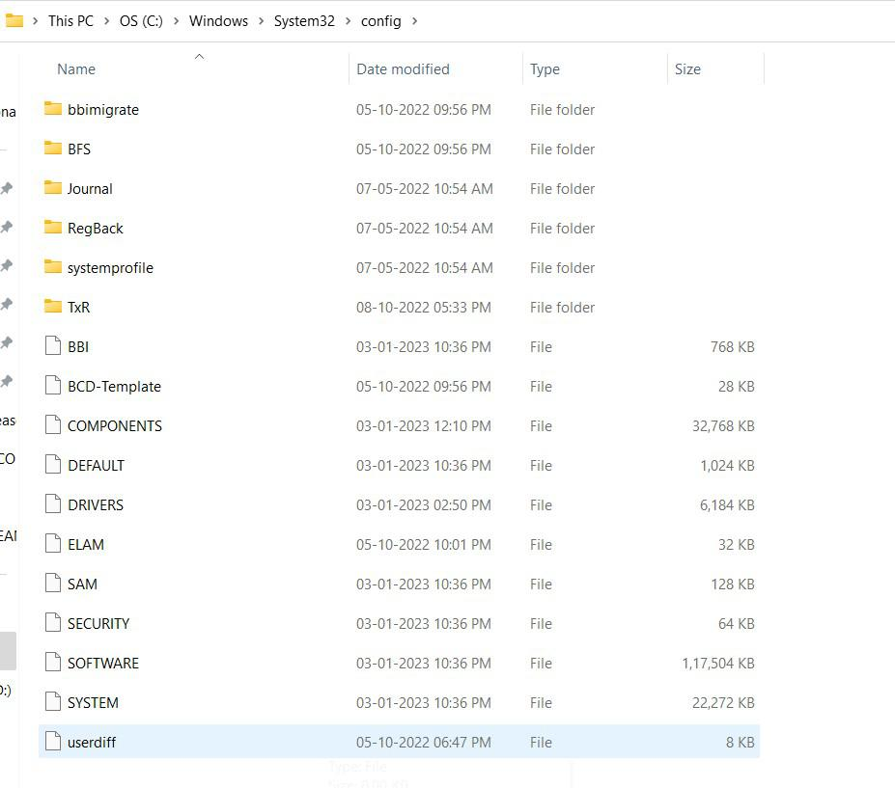
Example:
Step 1. You will need a USB bootable device that has kali Linux live version running on it.
Step 2. Next, you can see in the image below there are two files that stores user passwords and information in windows by the name SAM and SYSTEM.

Slide 22
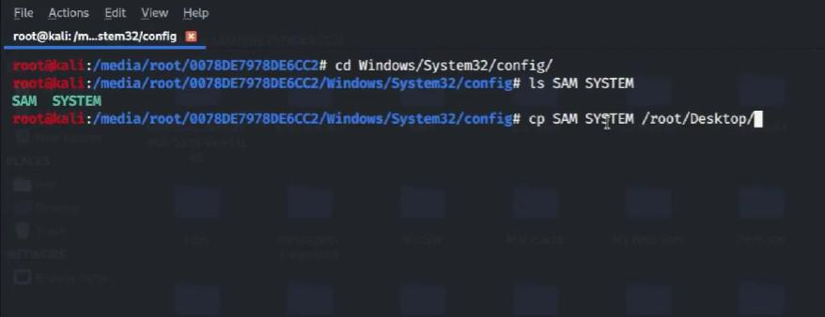
Example
Step 3. Now just attach your kali Linux live bootable USB to the system and boot into kali Linux.
Step 4. Now we will go to the path where the above two files are stored and we will copy them using the cp command into the desktop.

Slide 23
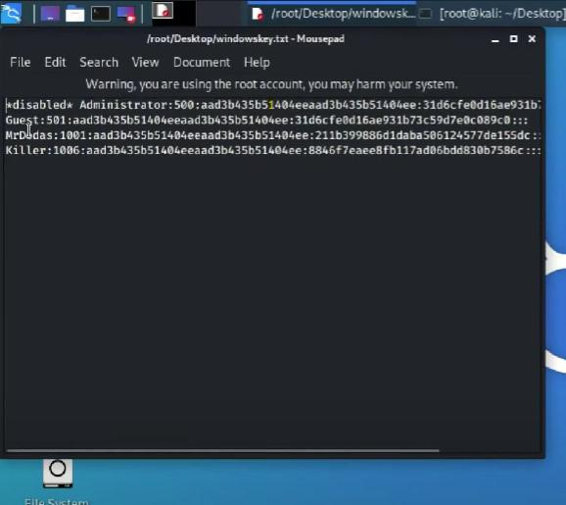
Example
Step 5. Now we will create a Hash to load into Ophcrack software for the cracking process, use the following command to do so after copying both files into the desktop.
$ samdump2 SYSTEM SAM -o windowskey.txt
Step 6. This will create a new file of hash on your desktop.

Slide 24
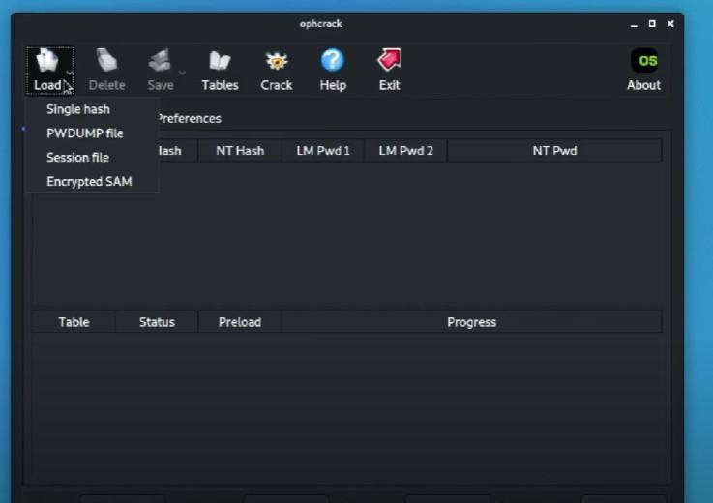
Example
Step 7. Now we need to download the rainbow tables from the official website, by the name window vista free, and then extract it.
Step 8. Now open Ophcrack and click on load and then click on PWDUMP and then choose the hash file we created earlier.

Slide 25
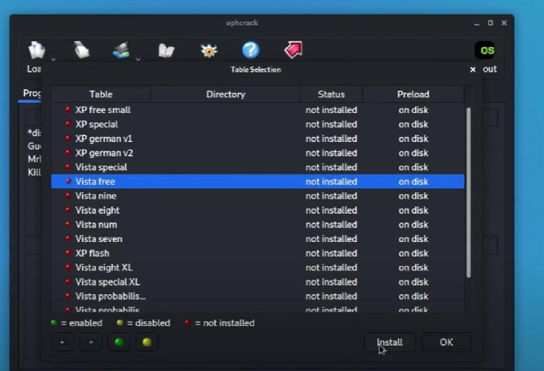
Example
Step 9. Now Go to and tables and click vista free and click install, then locate the file we have extracted with the name vista free in the above steps and click open.

Slide 26
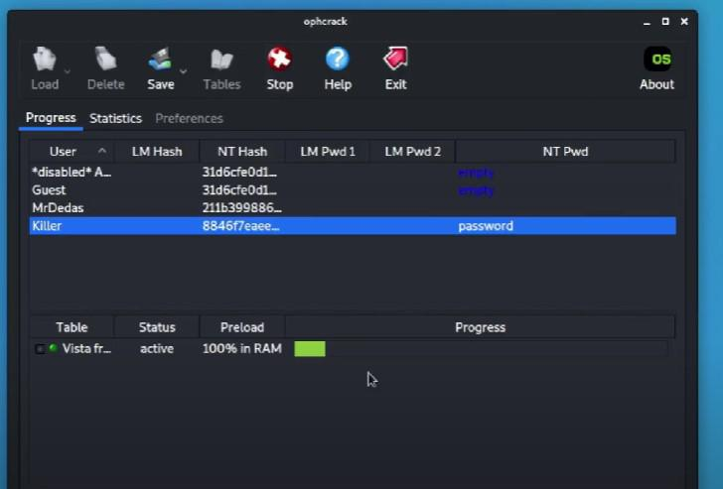
Example
Step 10. after this process is done simply click on crack, and you will see it starts the cracking process. based upon your password complexity it will take time.

Slide 27
Hashcat
It is a popular open-source software for cracking passwords that can crack various hashes using various attack modes.
It takes advantage of hardware acceleration from the GPU, which can perform computational tasks more efficiently than a general-purpose CPU could.
The speed of a GPU directly affects the cracking speed because a faster GPU can process more password guesses simultaneously, significantly reducing the time required to find the correct password.
Depending on the type of hash, the complexity of the password, and the GPU being used, Hashcat can test up to millions of password combinations per second during a brute force attack, greatly beyond the capacity of a CPU.

Slide 28
HASH
A hash is a fixed-length string representation created from the password using a hash function.
Simply put, a hash function takes input data and returns a fixed-length string through mathematical computations.
Once the data has been hashed, there is no way to reverse the process and retrieve the original data from the hash.
Here is an example of an MD5 hash of the password “password123”.

Slide 29
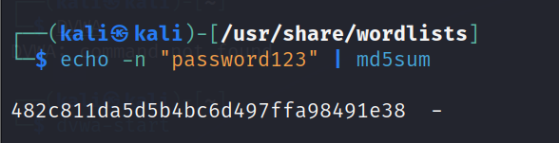
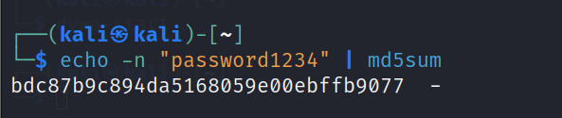
Hash - Examples

Slide 30
Password Lists for Hashcat
Password Lists In Kali
Kali comes pre-packaged with wordlists that can be used for cracking passwords.
The wordlist files are in the /usr/share/wordlists directory.
The one that is used the most, especially when doing a CTF (capture the flag), is the rockyou.txt file.
This file is massive, It contains over fourteen million user passwords.

Slide 31
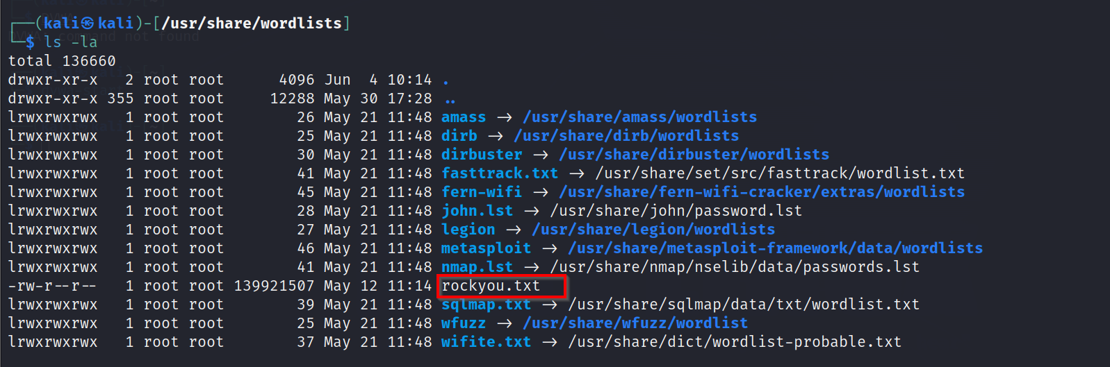

Slide 32
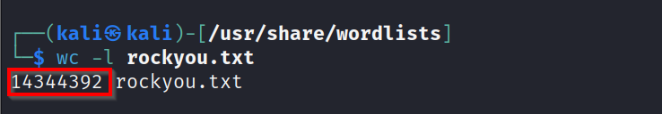
Hashcat
The rockyou.txt file comes from the over 32 million user credentials exposed due to a data breach in 2009 on the social media platform RockYou.
These passwords were kept in plain text, not hashed or otherwise obfuscated.

Slide 33
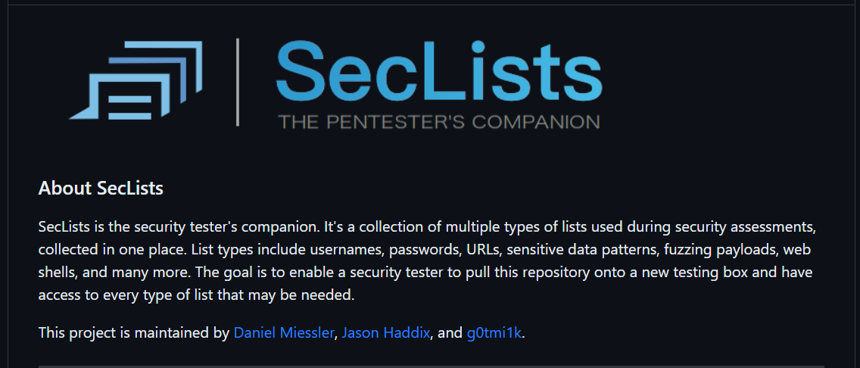
Other Locations for Password Lists
Another great resource for passwords is SecLists on GitHub.
This list contains many password lists, including “500-worst-passwords.txt” and “darkweb2017-top10000.txt.”
The password lists are collections of commonly used, default, or leaked passwords.

Slide 34
Three options for running Hashcat
1. Virtual Machine
Pros:
Environment Isolation: keeps your main OS separate from your Host OS
Ease of Setup: Hashcat is already installed on Kali
Testing and Experimentation: allows to test without affecting host OS.
Cons:
Performance Overhead: slower than running it on native hardware
Hardware Access: GPU passthrough can be complex and may not be supported on all systems.
Resource Allocation: Running intensive applications in a VM could impact the performance of the host system.

Slide 35
2. Host Machine
Pros:
Performance: Performs better than running it inside a VM.
Simplicity: It might be simpler to install and run
Cons:
Resource Consumption: Use as much of system's resources as possible to perform its tasks quickly.
System Compatibility: There can always be unforeseen compatibility issues or bugs that could impact its performance or stability on some systems.

Slide 36
3. Cloud
Pros:
Scalability: Cloud platforms offer the ability to easily scale up your resources.
Cost-Effectiveness: You only pay for what you use.
Access from Anywhere: Cloud environment can be accessed from anywhere
Cons:
Price: The costs can also add up quickly if you're running powerful instances for long periods of time.
Complexity: They can also be complex to set up and manage.
Legal and Ethical Considerations: Using cloud resources for cracking passwords might violate the provider's terms of service.

Slide 37
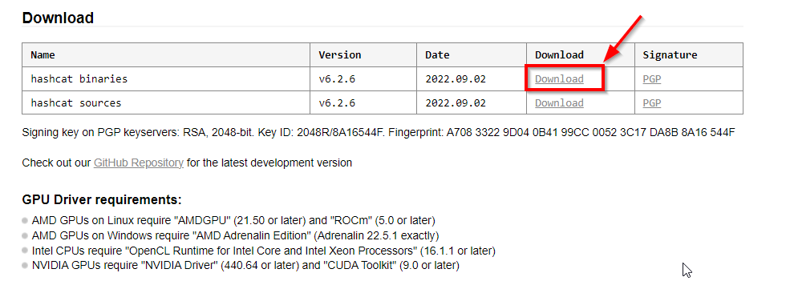
Installing Hashcat on Windows
The first step is to download the binary from the Hashcat site.

Slide 38
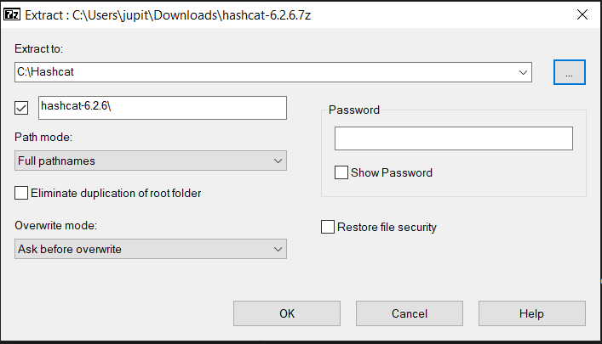
Once downloaded, you will need to extract the 7Zip file, we put ours in the C:\Hashcat folder, but you can put yours wherever makes the most sense for you.

Slide 39
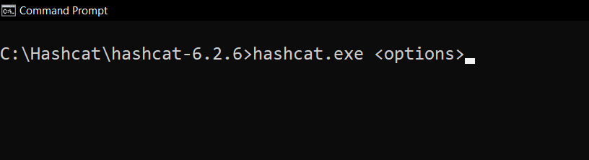
To start using Hashcat in Windows, head to the command line and move into the directory you saved it.
Next, you need to load hashcat.exe and any options you want to run.

Slide 40
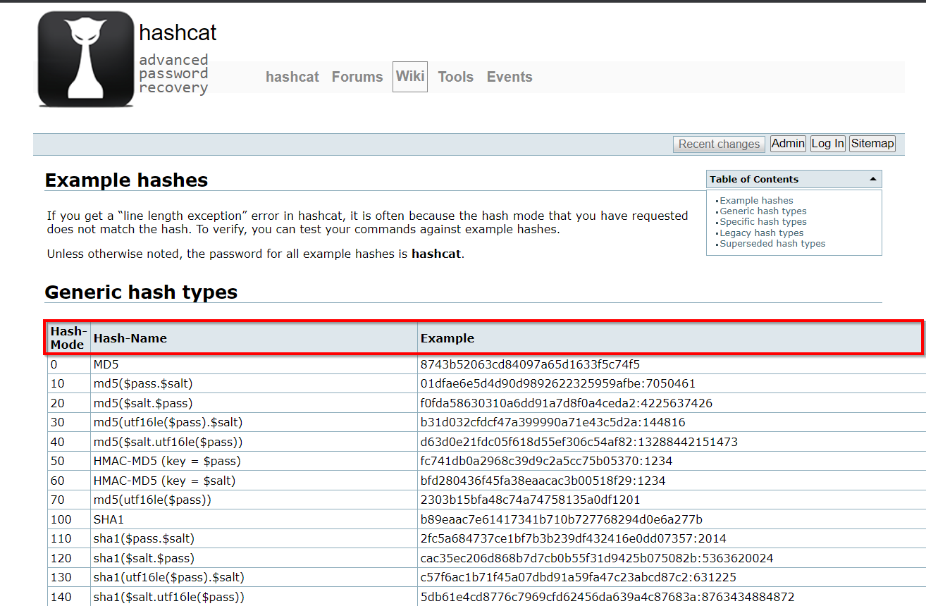
How to Use Hashcat
Hashes Available in Hashcat
The Hashcat Wiki has a great resource for finding all the hashes that work with the program.
It gives you a table view of hashes.

Slide 41
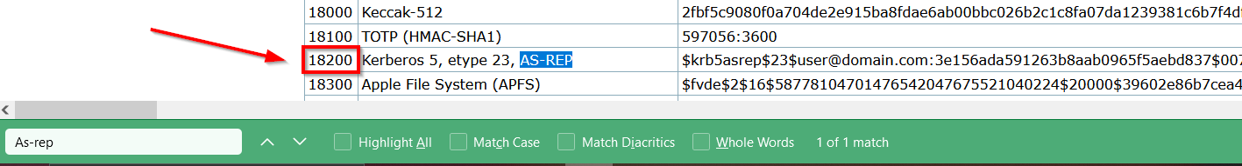
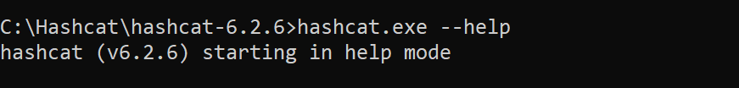
How to Use Hashcat
You can easily search through this with the find command in your browser. This will help you find which hash mode to use with the hash you need to crack.
You can also view the list of hashes from the command line using
--help.

Slide 42
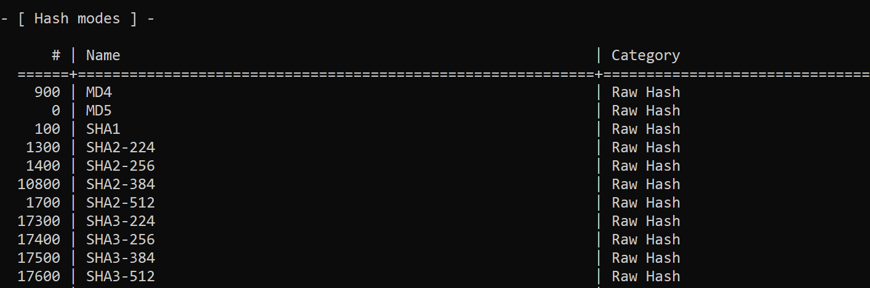
How to Use Hashcat
And scroll down a little until you see the section titled “Hash modes.”
On a Linux system, you can also use the grep command to search quickly for a specific hash, such as hashcat --help | grep md5.

Slide 43
Hydra
Hydra is one of the favorite tools of security researchers and consultants.
Being an excellent tool to perform brute force attacks, it provides various other options which can make your attack more intense and easier to gain unauthorized access to the system remotely.
Hydra – a very fast network logon cracker which supports many different services.
It is a parallelized login cracker which supports numerous protocols to attack.
New modules are easy to add, besides that, it is flexible and very fast.

Slide 44
Hydra
This tool gives researchers and security consultants the possibility to show how easy it would be to gain unauthorized access from a remote to a system.
Currently this tool supports:
adam6500, afp, asterisk, cisco, cisco-enable, cvs, firebird, ftp, ftps, http[s]-{head|get|post}, http[s]-{get|post}-form, http-proxy, http-proxy-urlenum, icq, imap[s], irc, ldap2[s], ldap3[-{cram|digest}md5][s], mssql mysql(v4), mysql5, ncp, nntp, oracle, oracle-listener, oracle-sid, pcanywhere, pcnfs, pop3[s], postgres, rdp, radmin2, redis, rexec, rlogin, rpcap, rsh, rtsp, s7-300, sapr3, sip, smb, smtp[s], smtp-enum, snmp, socks5, ssh, sshkey, svn, teamspeak, telnet[s], vmauthd, vnc, xmpp

Slide 45
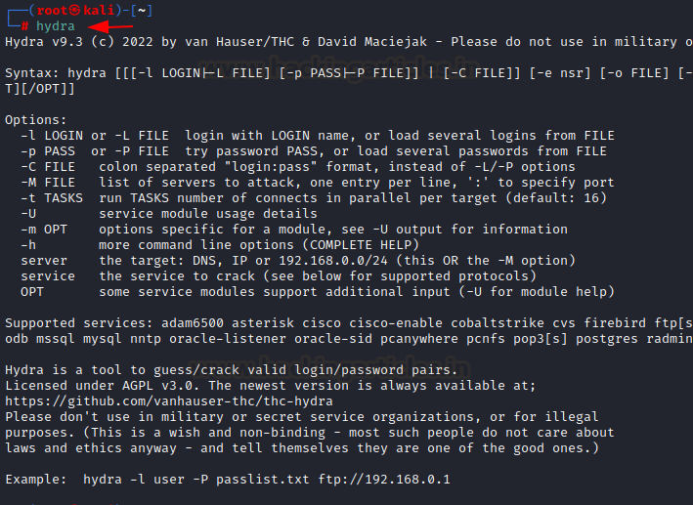
Hydra
For most protocols, SSL is supported (e.g., https-get, ftp-SSL, etc.).
If not, all necessary libraries are found during compile time, your available services will be less.
Type “hydra” to see what is available.

Slide 46
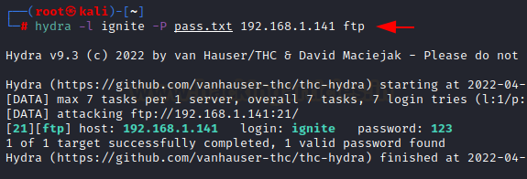
To guess Password for specific username
If you have a correct username but want to login without knowing the password, so you can use a list of passwords and brute force on passwords on the host for ftp service.
hydra -l ignite -P pass.txt 192.168.1.141 ftp
Here -l option is for username -P for password lists and host ip address for ftp service.
For login ignite password 123 made success.

Slide 47
To guess username for specific password
You may have a valid password but no idea what username to use.
Assume you have a password for specific ftp login.
You can brute force the field with correct username wordlists to find the correct.
You can use the -L option to specify user wordlists and the -p option to specify a specific password.
hydra -L users.txt -p 123 192.168.1.141 ftp
Here, our wordlist is users.txt for which -L option is used, and password is 123 and for that -p option is used over ftp.

Slide 48
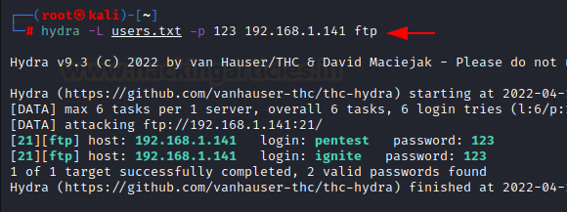

Slide 49
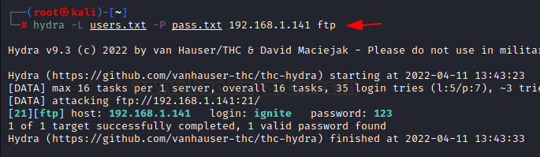
Brute forcing Username and Password
Now if you don’t have either of username or password, for that you can use a brute force attack on both the parameters username and password with a wordlist of both and you can use -P and -U parameters for that.
hydra -L users.txt -P pass.txt 192.168.1.141 ftp
Users.txt is wordlist for username and pass.txt is wordlist for password and the attack has displayed valid credentials ignite and 123 for the host.

Slide 50
Verbose and Debug Mode
-V option is used for verbose mode, where it will show the login+pass combination for each attempt.
Here, we have two wordlists users.txt and pass.txt so the brute force attack was making combinations of each login+password and verbose mode showed all the attempts.
hydra -L users.txt -P pass.txt 192.168.1.141 ftp -V
Here the users.txt has 5 usernames and pass.txt has 7 passwords so the number of attempts was 5*7= 35 as shown in the screenshot.
Now is the -d option used to enable debug mode. It shows the complete detail of the attack with wait time, conwait, socket, PID, RECV
hydra -l ignite -P pass.txt 192.168.1.141 ftp -d

